Slide 1
Digital Portfolio
STUDENT NAME:
Shifa.S
REGISTER NO:
31224u50040
NMID:
astvu31231224u50040
DEPARTMENT:
ARTIFICIAL INTELLIGENCE
COLLEGE :
COLLEGE/ UNIVERSITY
ISLAMIAH WOMENS ARTS AND
SCIENCECOLLEGE

Slide 2
PROJECT
TITLE
Interactive Digital Portfolio
using Front End Development

Slide 3
AGENDA
1.Problem Statement
2.Project Overview
3.End Users
4.Tools and Technologies
5.Portfolio design and Layout
6.Features and Functionality
7.Results and Screenshots
8.Conclusion
9.Github Link

Slide 4
PROBLEM
STATEMENT
In today’s competitive world, students and developers often struggle to find where they can truly showcase what they’re capable of. Without a personal website or portfolio, it’s not easy,especially when applying for internships, jobs. That’s why having a digital portfolio isn’t just helpful—it’s essential.

Slide 5
PROJECT OVERVIEW
This portfolio website is something I created to represent who I am—both as a student and a Editor. It’s a place where I’ve brought together my skills, my projects, and my achievements in one clean, easy-to-navigate space. Built using HTML, CSS, and a touch of JavaScript, the site reflects my personality and passion for tech. It’s responsive, visually appealing, and designed to make a strong first impression.

Slide 6

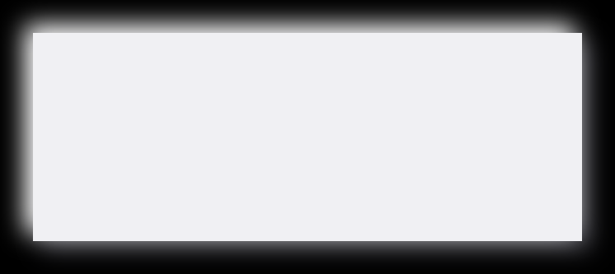
End Users
of my Portfolio
Employers
They get a richer picture than just grades—real work and real skills
Teachers
They use it to track progress, give smarter feedback, and support each student’s journey.
Parents
It’s a window into their child’s learning—what they’re proud of, what they’re working on
Students
It’s their personal space to show off projects and skills. AI helps them improve, and even prep for college

Slide 7

For structuring the content and layout
HTML
Tools and Technologies
02
CSS
For styling, colors, fonts, and responsive design
03
For interactive elements like buttons and potential future enhancements.
JS
04

Slide 8






PORTFOLIO DESIGN AND LAYOUT
Projects: Highlighted cards for each project with short descriptions
Certificate: Visual proof of achievement with styled borders
About Me:
A personal description of my background and interests
Skills:
Listed with icons and beginner-friendly explanations
Contact Form: Clean and functional for easy communication

Slide 9
FEATURES AND FUNCTIONALITY
- Smooth scroll navigation
- Hover effects on project cards
- Responsive design for mobile and desktop
- Contact form with input validation
- Visual elements like emojis and icons to make it more engaging
- Organized sections for clarity and flow

Slide 10
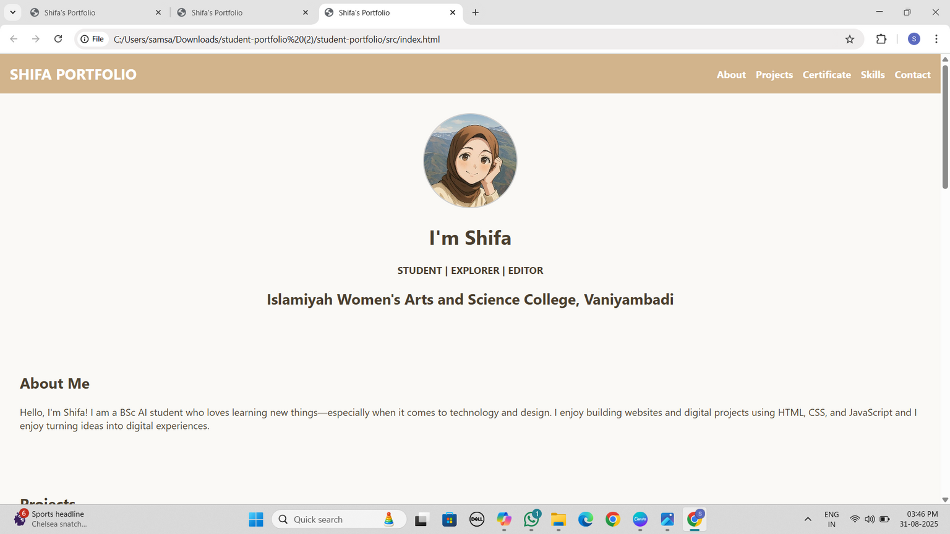
result and screenshot

Slide 11
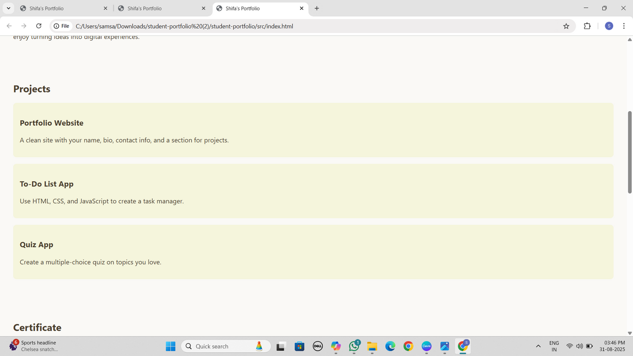
result and screenshot

Slide 12
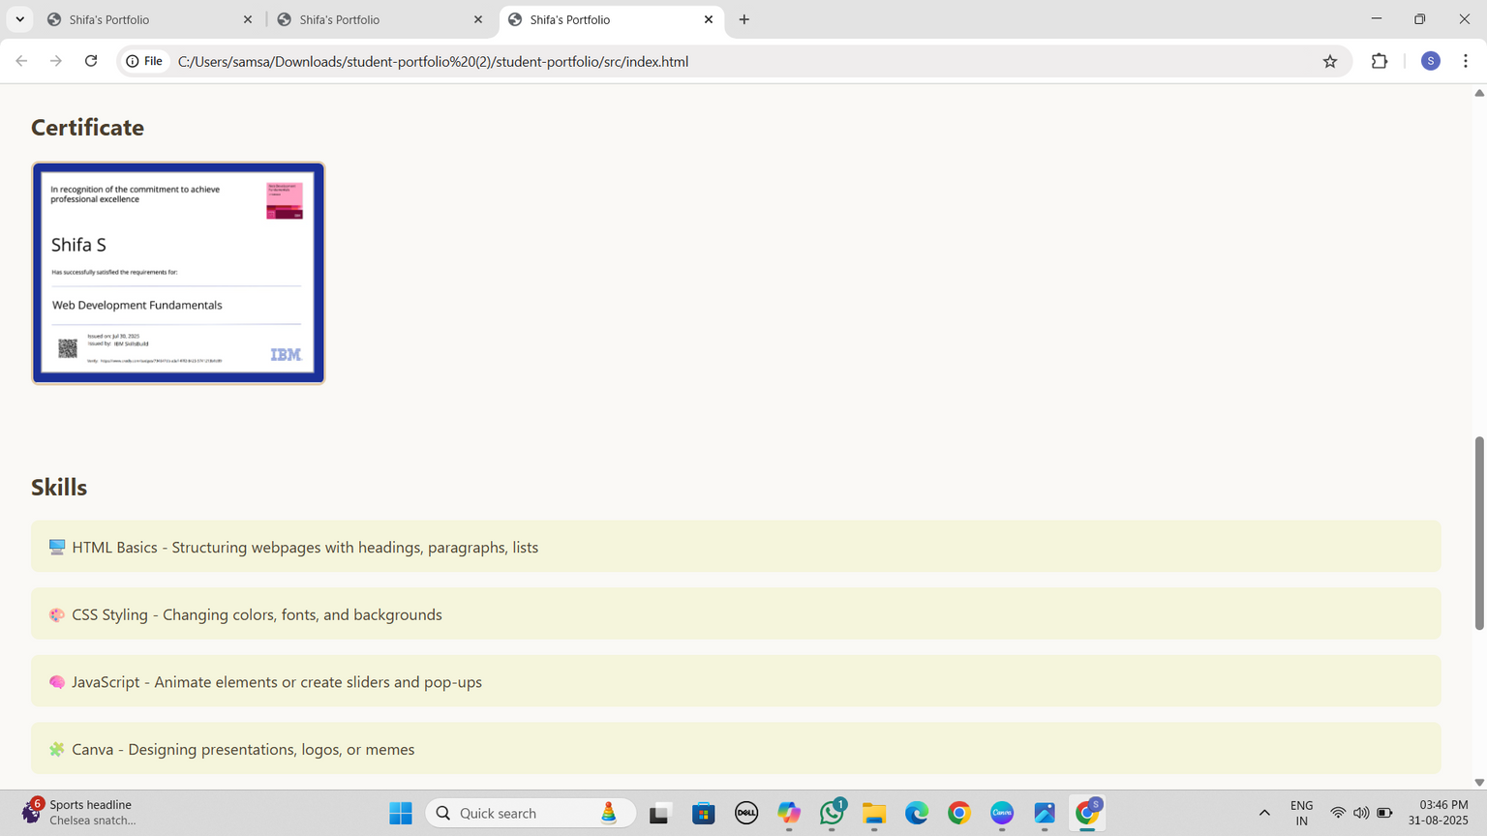
result and screenshot

Slide 13
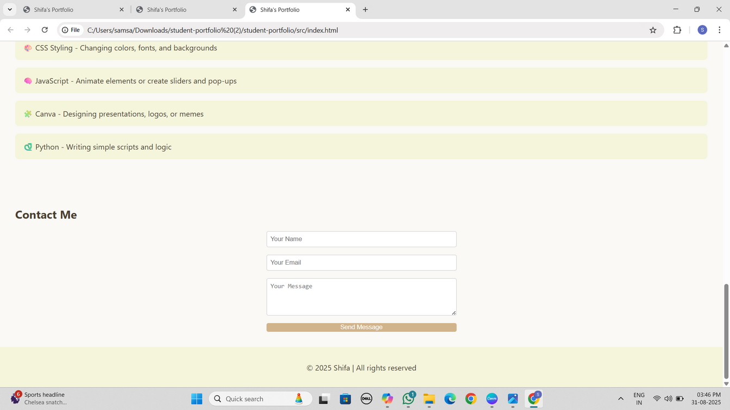
result and screenshot

Slide 14
CONCLUSION
This portfolio is more than just a website—it's a reflection of my learning journey, creativity, and passion for technology. It’s designed to grow with me as I learn new skills and build new projects. I’ve kept it simple, approachable, and expressive so that it feels like me.
🔗 GITHUB LINK

